Slide 1

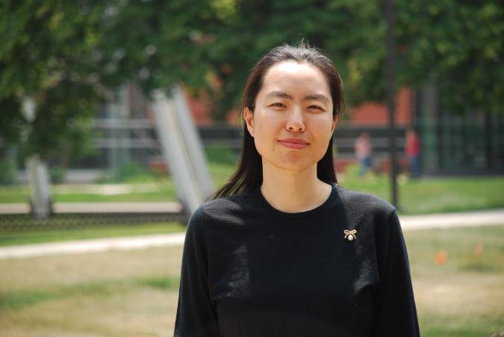
Qi Li
My name
Name can tell a lot
Gender, Ethnicity, Age, Religion, …
Important feature for many NLP tasks
My background
BS. Math
MS. Stats
PhD. CS
Computer Science

Slide 2
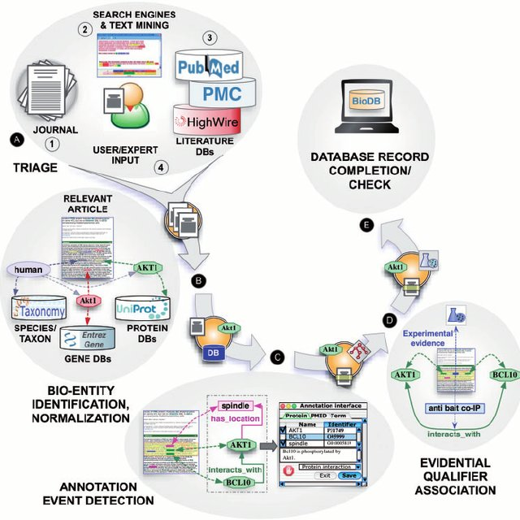

My research
NLP -- Information extraction
Generation models
Applied ML
Knowledge & Insights
Computer Science

Slide 3
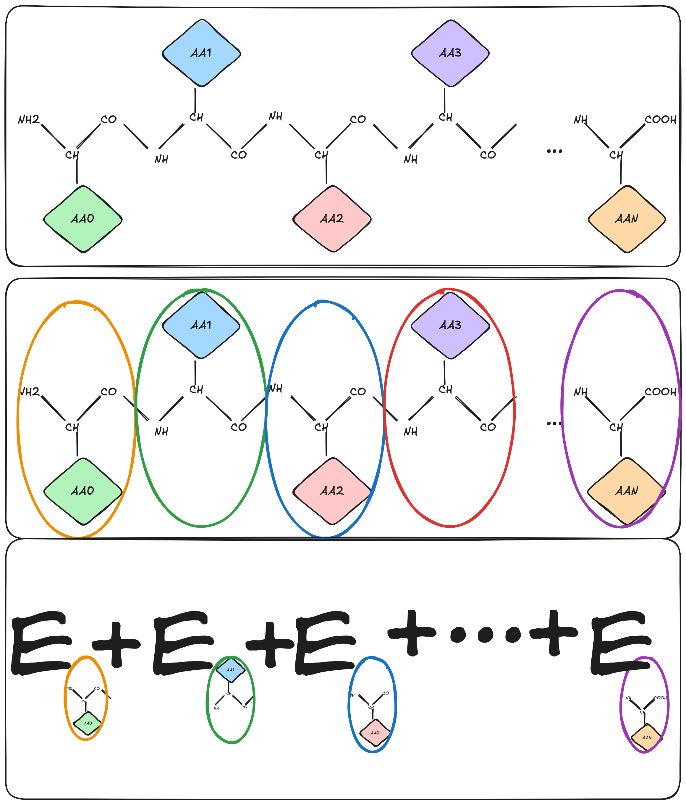
SIMCODES Project: Developing components for automating fragmentation
Mentee: Gabriela and Devarsh
Goals:
Function for identifying amino acids in a protein.
Function for splitting a protein by amino acid.
Idea: protein as an unnatural language
Computer Science

